Slide 1
P141 – TeLE COMMUNICATION CHURN mentor : Rajshekar SIR Project Coordinator : Pallavi ma’am Group : 1
Name | Email | Contact | Projects
D. Lily Susanna | lily.susanna1995@gmail.com | 9131801436 | Vikram Reddy boppa
Mr. Sanath Shanmugam | sanathshannu12@gmail.com | 7022444380 | Bharath
Mr. Ronit Kumar Nayak | ronitnayakix@gmail.com | 7470946215 | Bharath
Ms. Padma Priya Dagani | priyapadhu13@gmail.com | 8331885150 | Gokhul
Rahul Boyidapu | rahullals1234@gmail.com | 7036629190 | Hema
Mr Shubham Swarnakar | shubham2swarnakar@gmail.com | 9790757703 | Vikram Reddy Boppa,
Mr. Akash Jain | jainakash1799@gmail.com | 6360406167 | Sanskar/Shruthi

Slide 2
Project on Telecommunication churn
Objective:
Customer churn is a big problem for telecommunications companies. Indeed, their annual churn rates are usually higher than 10%. For that reason, they develop strategies to keep as many clients as possible. This is a classification project since the variable to be predicted is binary (churn or loyal customer). The goal here is to model churn probability, conditioned on the customer features.
Dataset details:
Data Set Details: The data file telecommunications_churn.csv contains a total of 19 features for 3333 customers. Each row corresponds to a client of a telecommunications company for whom it has been collected information about the type of plan they have contracted, the minutes they have talked, or the charge they pay every month.

Slide 3
Hypotheses Generation
Account Length : The number of days that this account has been active.
Voice Mail Plan : Whether the customer has a voice mail feature: yes/no.
Voice Mail Message : Presumably the average number of voice mail messages per month.
Day Mins : The total number of calling minutes used during the day.
Night Mins : The total number of calling minutes used during the Night.
Evening Mins : The total number of calling minutes used during the evening.
International Mins : The total number of international minutes.
Customer Service Calls : The number of calls placed to Customer Service.
International Plan : Whether the customer has an international calling plan: yes/no.
Day Calls : The total number of calls placed during the day.
Day Charge : The billed cost of daytime calls.
Evening Calls : The total number of calls placed during the evening.
Evening Charge : The billed cost of evening time calls.
Night Calls : The total number of calls placed during the night.
Night Charge : The billed cost of nighttime calls.
International Calls : The total number of international calls.
International Charge : The billed cost for international calls.
Total Charge : The total cost summing day, eve, night, international charges.
Churn : Whether the customer left the service: true/false.

Slide 4
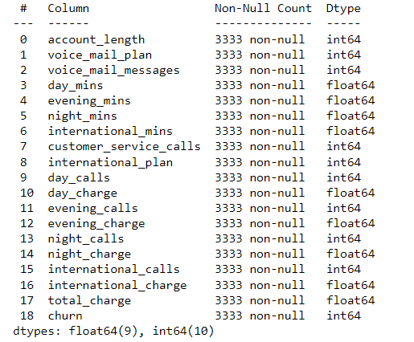
Exploratory Data Analysis (EDA)
1. There are 3333 Rows and 19 columns
2. We check the data types and nullability of columns

Slide 5
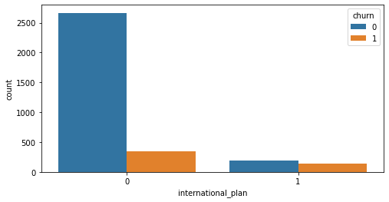
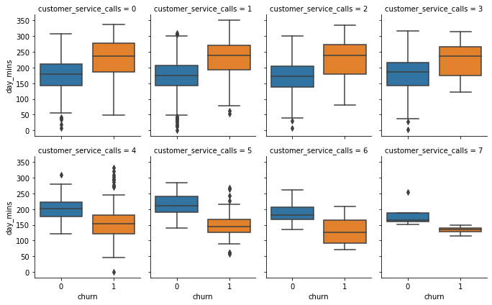
1. When International Plan is enabled, the churn rate is much higher; the usage of the international plan by the customer is a strong feature. We do not observe the same effect with Voice mail plan. 2. Starting with 4 calls, total day minutes may no longer be the main factor for customer churn. Day minutes have also reduced by increase in customer service calls.
1
2

Slide 6
A higher number of calls placed to customer service in a given period indicates that a customer is facing many problems, and hence, there is a high potential of churning.
Customers with high total billed cost are more likely searching for another operator if they are unhappy with the current service.
Night minutes is almost equal while increase in customer service call. churn is also same pattern as not churn.
Starting with 4 calls, total evening minutes may increased of not churn.
With increase in customer call, total international minutes may be the good factor for customer churn.

Slide 7
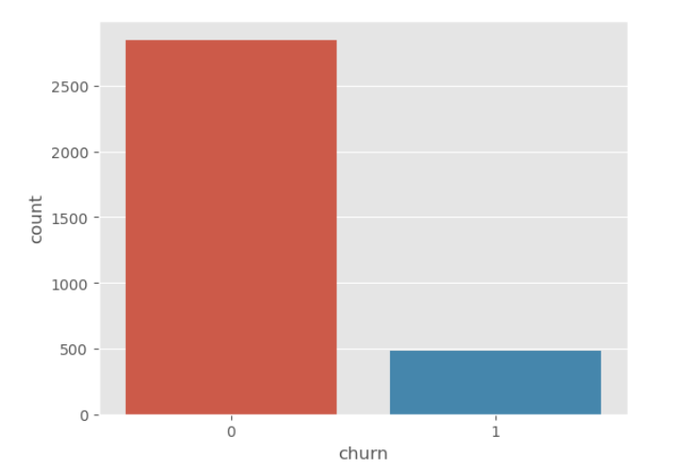
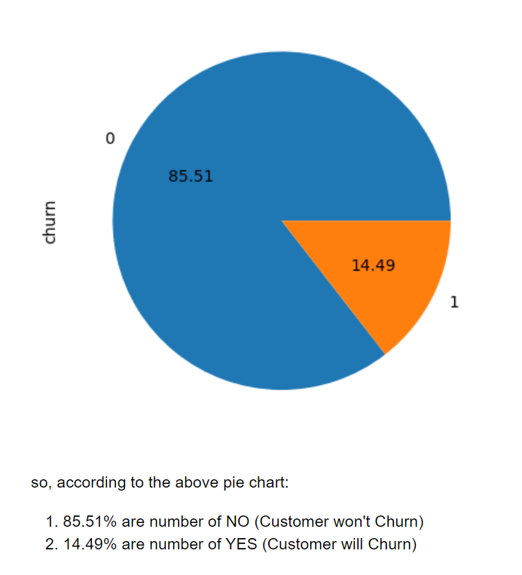
Churn VS Non-Churn :
The above bar plot shows the percentage of observations that correspond to each class of the response variable: no(0) and yes(1). This is an imbalanced data set because both classes are not equally distributed among all observations, being no the majority class more than 83%. When modeling, this imbalance will lead to a large number of false negatives.
By this we can also conclude that:
Churn vs Non-churn customers ratio is 1:6
Churn minority class - 483 customers
Non-churn - majority class - 2850 customers

Slide 8
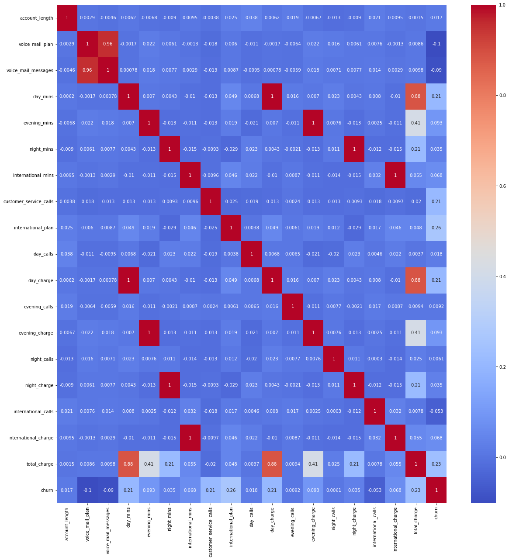
Correlation Matrix

Slide 9
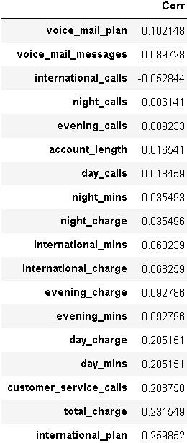
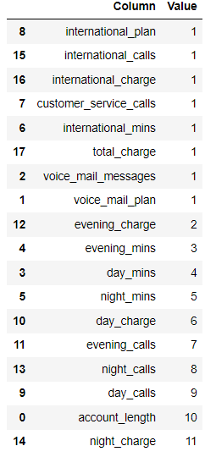
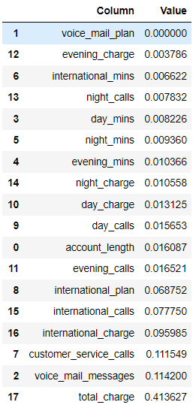
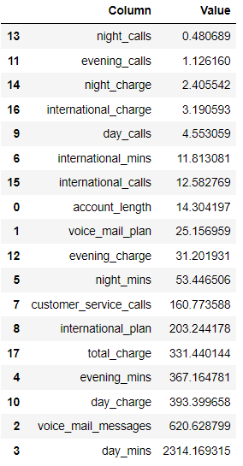
Features Selection
We have applied four kind of Feature selection:
Correlation
RFE model (Reccursive Feature Elimination)
Decision Tree importance
Univarient Selection
RFE MODEL
Decision Tree
Univarient Selection

Slide 10
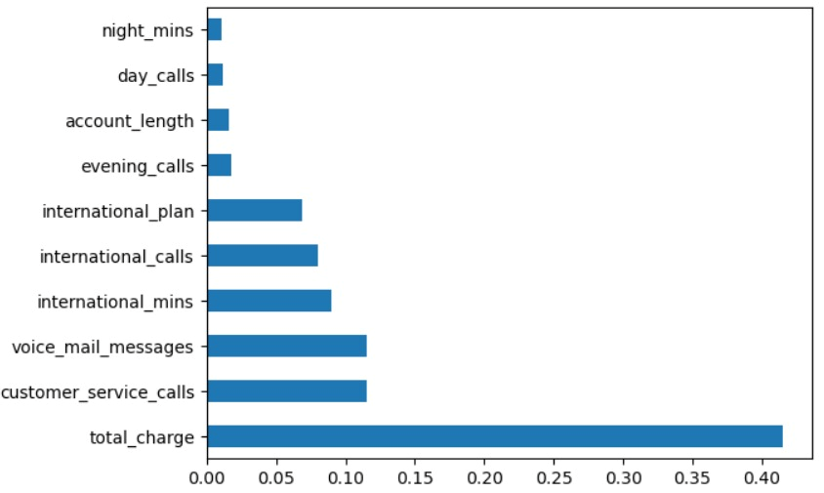
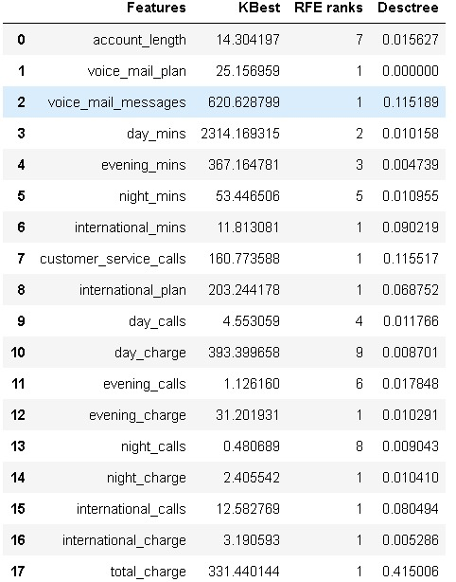
Final Feature selection
Based on the Feature importance we have eliminated a few features and finalised the features having high importance score

Slide 11
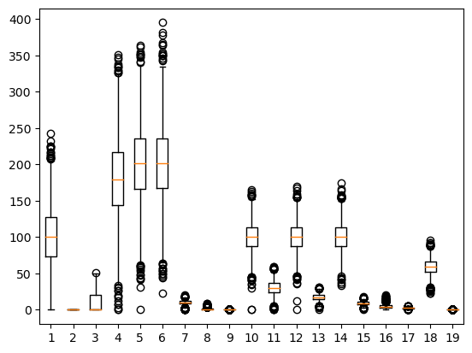
Detecting Outliers
Plotted outliers for all features using boxplot
If outliers were very high in number then used z-scores also to plot outliers
Then took the intersection (common) of both boxplot and z-scores to get outliers
Checked outliers for each columns.
Decided to keep the outliers as it was not confirmed whether they were measurement or data entry errors.

Slide 12
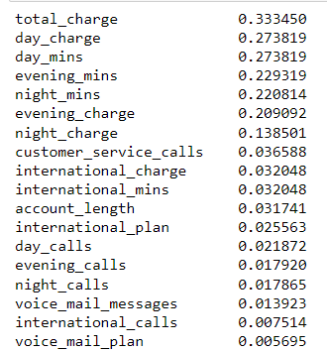
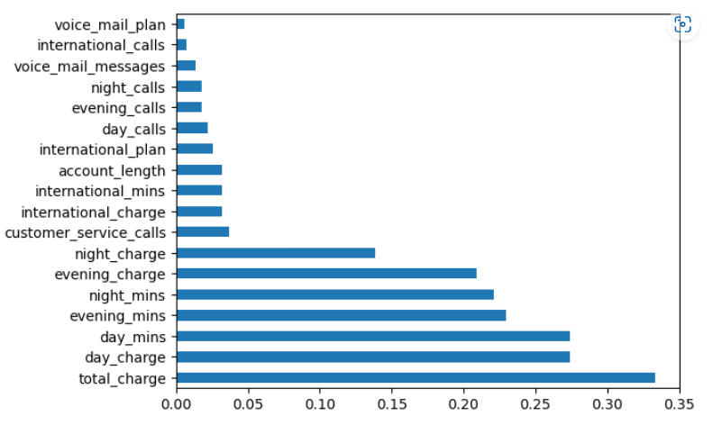
Feature IMportance
Mutual information score measures the mutual dependency between two variables based on entropy estimations
Higher values of mutual information show a higher degree of dependency which indicates that the independent variable will be useful for predicting the target. Mutual information allows us not only to better understand our data but also to identify the predictor variables that are completely independent of the target.
As shown above, Voice Mail Plan and international calls have a mutual information score really close to 0, meaning those variables do not have a strong relationship with the target. This information is in line with the conclusions we have previously drawn by visualizing the data. In the following steps, we should consider removing those variables from the data set before training as they do not provide useful information for predicting the outcome.

Slide 13
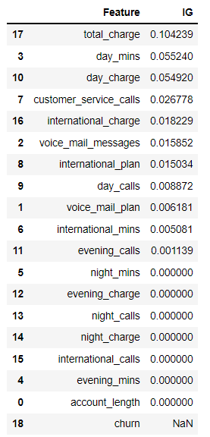
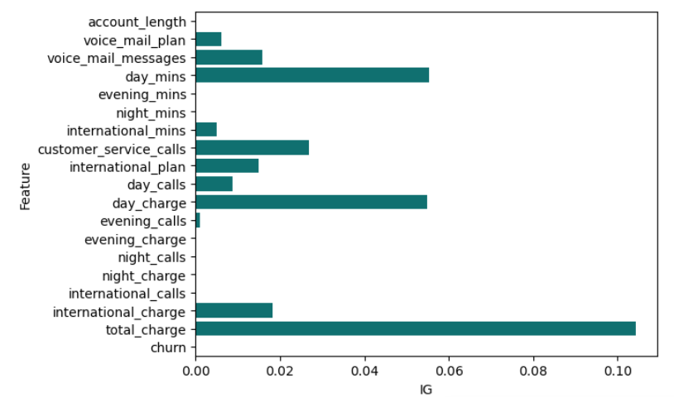
Feature Engineering
Mutual Information Gain / Anova Test
Mutual Information Gain
Information Gain measures the reduction in entropy or surprise by splitting a dataset according to a given value of a random variable. A larger information gain suggests a lower entropy group or groups of samples, and hence less surprise. Lower probability events have more information, higher probability events have less information. Entropy quantifies how much information there is in a random variable, or more specifically its probability distribution. A skewed distribution has a low entropy, whereas a distribution where events have equal probability has a larger entropy.

Slide 14
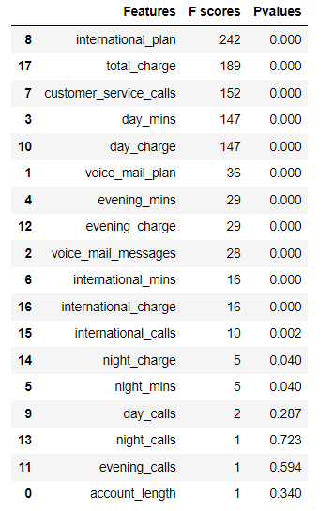
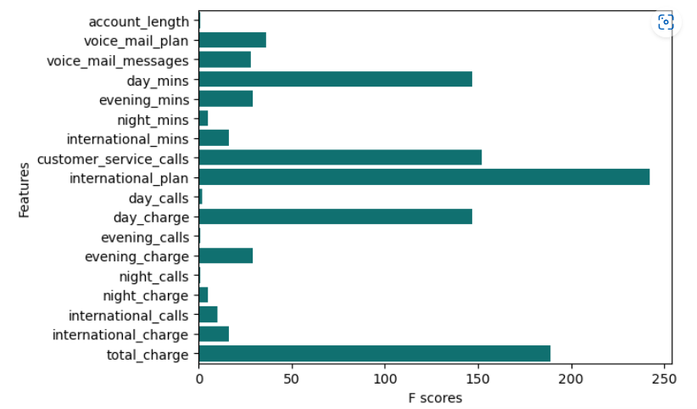
('total_charge', 'customer_service_calls', 'international_plan') == important features
('day_mins' & 'day_charge') == drop due to multicollinearity
('total_charge','customer_service_calls', 'international_plan', 'international_charge') == final important features
Anova Test
1. Analysis of Variance is a statistical method, used to check the means of two or more groups that are significantly different from each other. It assumes Hypothesis as
2. H0: Means of all groups are equal.
3. H1: At least one mean of the groups are different.

Slide 15
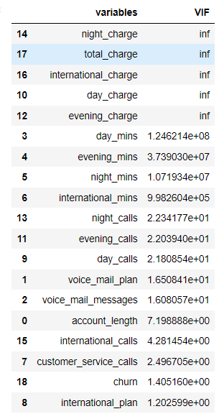
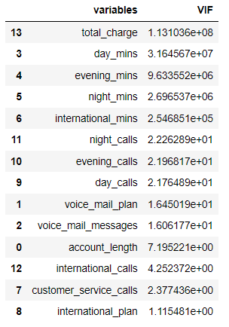
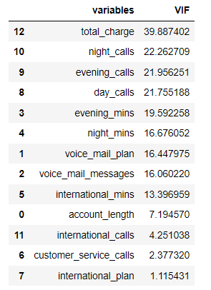
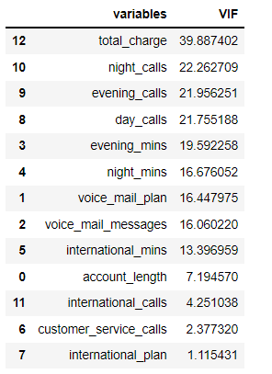
Multicollinearity - Variance Inflation Factor (VIF)
Again plotting vif for remaining 15 features
Deleted these variables as they are 100% related(from corelation matrix) to international_mins, night_mins,evening_mins,day_mins respectively
Deleting day_mins as it has 88% correlation with total charge
Now deleting more features can cause loss of information

Slide 16
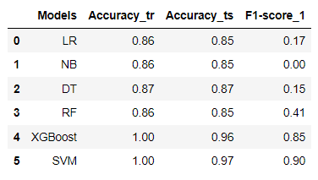
Model Evaluation
Logistic Regression
Random Forest
Gaussian Naïve Bayes
Support Vector Machine (SVM)
Decision Tree
XG Boosting
Accuracy is high for DT, XG Boost & SVM
F1 score is good for XG Boost & SVM
F1 score is very low for all other models

Slide 17
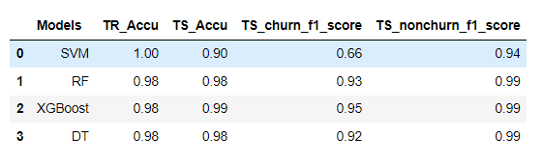
Selection of model:
Model was Selected Based on the Cross Validation Score and Standard Deviation
Model Optimization - GridSearchCV

Slide 18
Finalizing the model
Model Name | Accuracy Score | Standard Deviation
LR | 0.85057 | 0.01498
DT | 0.95229 | 0.00498
SVM | 0.85507 | 0.01787
NB | 0.85478 | 0.00702
RF | 0.97869 | 0.00319
XGB | 0.97809 | 0.00293
Based on the above results we can see that XGB model and RF model are yielding a high accuracy score
Out of the 2 models XGB model has a slightly lower standard deviation , so we have finalize XGB as final model

